Slide 1


UNITE 2023
ROBOTICS WITH AI MACHINE VISION
Speaker
Joshua Lunn

Slide 2
Today's Plan
Introductions
Development Setup
01
04
Arduino IDE setup and code downloaded
Robotics
Robot Movement
02
05
l
How do we control the robot?
Computer Vision
Make it move
03
06
What is it? How can we use it?
We will program the robot to do something

Slide 3

Joshua Lunn
SW Engineer @ CSLabs
EE Degree from MSU
Founded 2 Startups
Mentor for FTC Robotics Team
AI/ML, Wireless, IoT, Embedded Systems

Slide 4
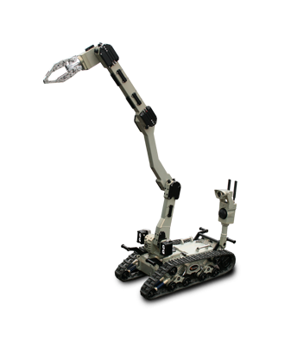
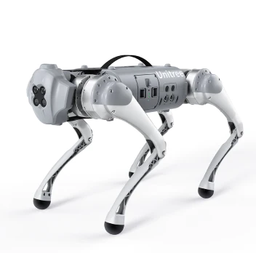
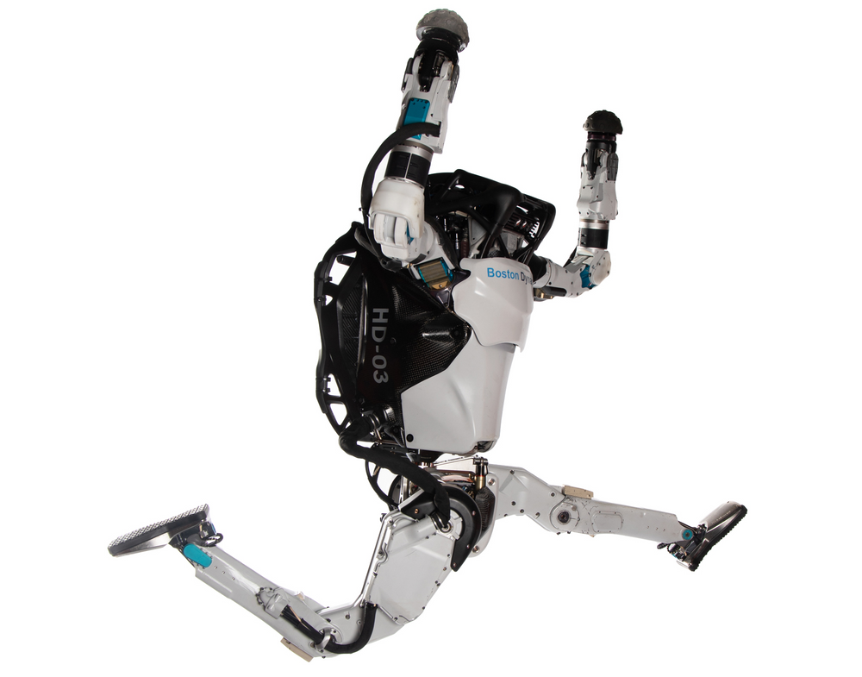
Robotics

Slide 5
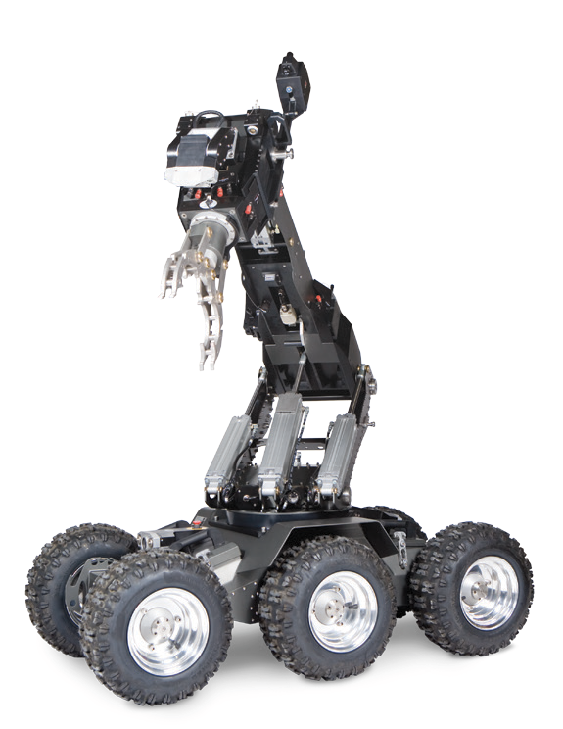
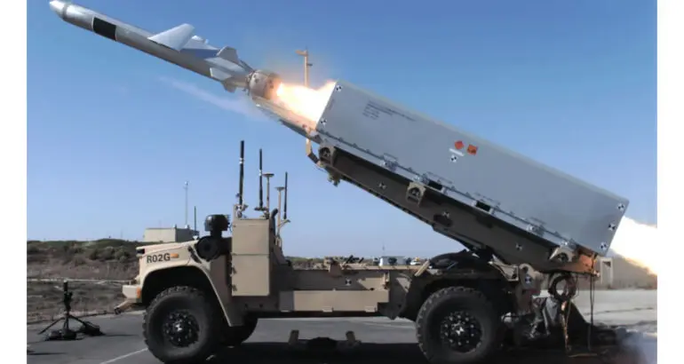
Robotics

Slide 6
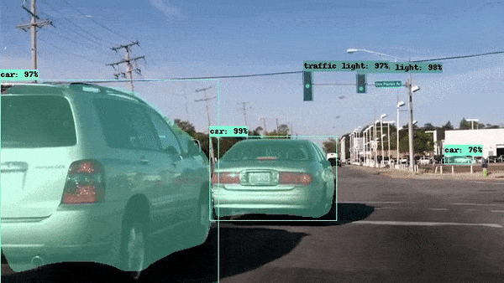
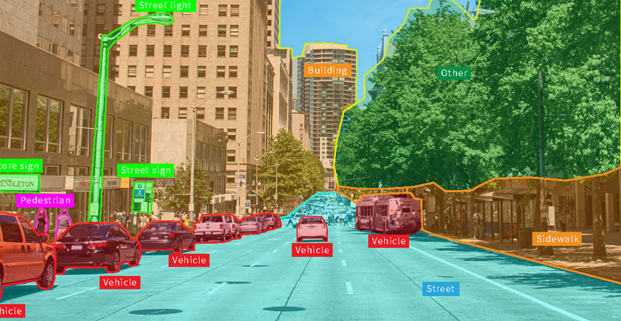
Computer Vision
Allows computers to see, observe, and understand.

Slide 7
Break

Slide 8
Today's Plan
Introductions
Development Setup
01
04
Arduino IDE setup and code downloaded
Robotics
Robot Movement
02
05
l
How do we control the robot?
Computer Vision
Make it move
03
06
What is it? How can we use it?
We will program the robot to do something

Slide 9
The Code
HTTPS://BIT.LY/46oE882

Slide 10
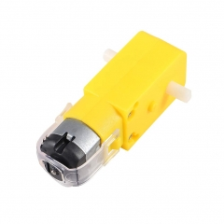
Motors
Rated Voltage
3-6V
Nominal Battery Voltage
3.7V
We have 2 batteries
7.4V

Slide 11
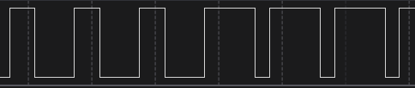
PWM
analogWrite(pwmAPin, motorSpd);
motorSpd can be 100-255, why not 0 - 255?

Slide 12
PWM
We have a dead zone from 0 - 100
Rated Voltage of Motor
3-6V
Nominal Battery Voltage
3.7V
We have 2 batteries
7.4V
100/255 * 7.4V = 2.9V

Slide 13
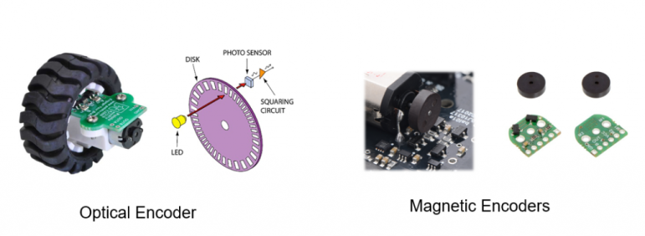
Tune the robot
Many robots use wheel or motor encoders for determine how far they have traveled
We don't have encoders so the best we can do is tune time and speed to distance

Slide 14
Break

Slide 15
Tune the robot
Measure 3 feet and mark with tape
Pick a speed between 100-200
Determine the time (t) needed to make robot stop on the tape
Tip: Put code in the setup() or add a large delay after the movement so the robot doesn't keep going

Slide 16
Tune the robot
Take the time number you came up with and divide by 3, this is your time to go 1 foot
Now tune for a 90 degree turn
Can you make the robot make a square and stop?

Slide 17
Thank You!
josh@thedaringwolf.com

